Slide 1

PUSL2019
Lesson 2 Database Architecture
1

Slide 2
Lesson Outline
What are the three levels in Database Architecture?
What is Data Modelling?
What are the three types of Data Models?
What is Database Schema and Instance?
What is Data Dictionary?
What is Data Independence?
What are the two levels of Data Independence?
2

Slide 3
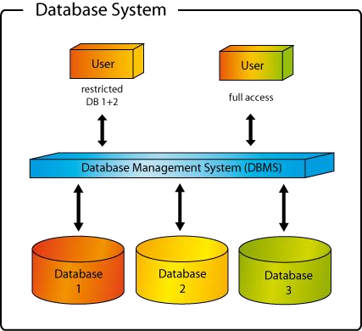
3

Slide 4
Database Architecture
3 Level ANSI-SPARC Architecture 3 Schema (3 Tier) Architecture
4

Slide 5
3 Schema (3 Tier) Architecture
External View (View Level )
Conceptual View (Logical Level)
Internal View (Physical Level)
5

Slide 6
External Level (View Level)
The users’ view of the database. This level describes the part of the database that is relevant to each user.
Describe how users or programs see the data.
Application programs hide details of data types.
Can hide some information (eg: Salary) for security purposes.
Different external views can be provided to different categories of users.
– different views of the database.
6

Slide 7
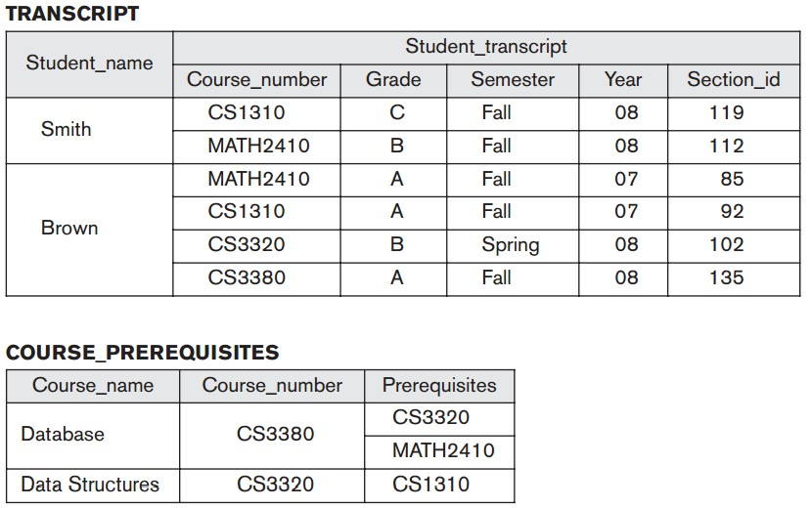
External Schema
7

Slide 8
External Views Allows to:
Hide unauthorized data
Eg: salary, dob
Provide user view
Eg: view employee name, designation, department data taken from employee and department files
Derive new attributes
Eg: age derived from DOB or NIC
Change unit of measurement
Eg: show age in years or months
Define security levels
Eg: update access to employee file
read only to department file
8

Slide 9
Logical level (Conceptual View)
The community view of the database. This level describes what data is stored in the database and the relationships among the data.
Defines the logical structure of the entire database.
Describes how data is stored in database, and the relationships among the data.
Defines the data types, field sizes, primary keys, foreign keys etc.

Slide 10
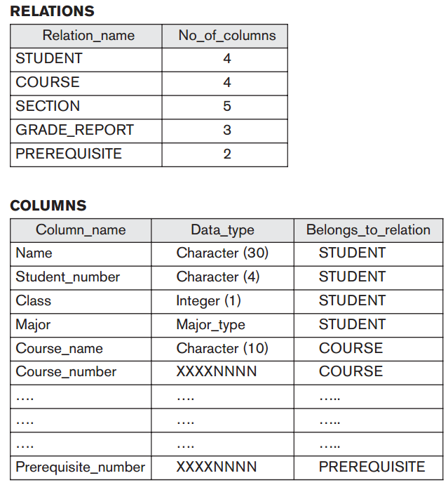
Conceptual Schema

Slide 11
Internal View (Physical Level)
The physical representation of the database on the computer.
Describes how the data is stored in the database in terms of record formats, file structures, indexes etc.
Describes how the files and indexes are used.
Describes how a record is stored.
Provides the disk drives and physical addresses.
Physical database design is the responsibility of the database administrator(DBA).

Slide 12
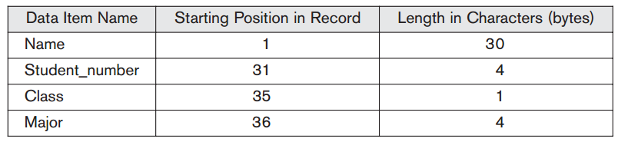
Internal Schema

Slide 13
Data Modelling
A collection of tools and techniques for describing data and their relationships when designing databases.
Conceptual Model
Logical Model
Physical Model
Business analyst uses conceptual and logical model for modeling the data required and produced by system from a business angle.
Database designer produces the physical model to determine how the database is physically implemented in the target DBMS.

Slide 14
Conceptual Model
Identifies the highest-level relationships between the different entities.
Include entities and the relationships among them.
No attribute is specified.
No primary key is specified.

Slide 15
Logical Data Model
Describes the data in detail, without regard to how they will be physical implemented in the database.
All attributes for each entity are specified.
The primary key for each entity is specified.
Foreign keys are specified.
Normalization occurs at this level.

Slide 16
Both Conceptual and Logical levels are entirely independent of all physical considerations (implementation details)
target DBMS
application programs
programming languages
hardware platform
performance issues etc.

Slide 17
Physical Model
Represents how the model will be built in the database.
Shows all table structures including
filed names
data types
constraints
primary keys
foreign keys (used to identify relationships)
relationships
access methods
security measures

Slide 18
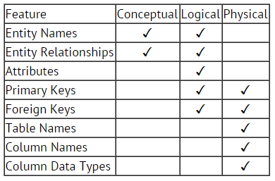
Data Modelling

Slide 19
Database Schema
The description of a database (layout of a DB).
It is not expected to change frequently.
– Schema changes are usually needed as the requirements of the database applications change.
Described using SQL CREATE statements.

Slide 20
Instance
The actual data in the DB at a particular time.
Also called as DB state, snapshot or occurrences.
The actual data in the database may change frequently
Eg: Changes every time when insert, update, delete records.
Many database instances can correspond to the same database schema.

Slide 21
Schema and Instance
Schema
– Similar to data type of a variable in a program.
Instance
– Similar to the value of a variable.

Slide 22
Data Dictionary (Meta Data)
Consists of the basic definitions or the organization of a database and its tables.
Contains a list of
all files in the database
the number of records in each file
the names and types of each field
the relationships that exists between various data items
Indexes that are used to access data quickly
The schema is speciﬁed during the database design process and is not expected to change frequently.

Slide 23
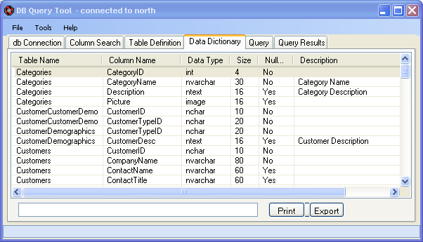
Data Dictionary (Meta Data)

Slide 24
Data Dictionary (Meta Data)
Most DBMS keep the data dictionary hidden from users to prevent them from accidentally destroying its contents.
Data dictionaries do not contain any actual data from the database, only bookkeeping information (Data about Data) for managing it.
Without a data dictionary, a DBMS cannot access data from the database.

Slide 25
Data Independence
The capacity to change the schema at one level of the database system without affecting to the schema at the next higher level.
Upper levels are unaffected by changes to lower levels.
There are two kinds of data independence
Logical data independence
Physical data independence

Slide 26
Logical Data Independence
The capacity to change the conceptual schema without changing the external schema or application programs.
After a logical reorganization, application programs that reference the external schema must work as before.
Eg: addition or removal of new entities, attributes, constraints, relationships, should be possible without having to change existing external schemas or having to rewrite application programs

Slide 27
Physical Data Independence
The capacity to change the internal schema without changing the conceptual schema and external schema.
Changes to the internal schema may be needed because some physical files were reorganized.
Eg:
– Change the storage media, file organization (indexed, sequential, random)

Slide 28
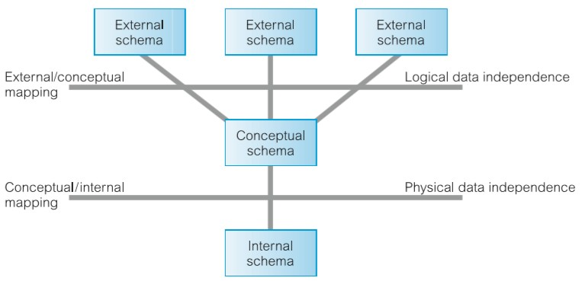
Data Independence

Slide 29
Lesson Summary
What are the three levels in Database Architecture?
What is Data Modelling?
What are the three types of Data Models?
What is Database Schema and Instance?
What is Data Dictionary?
What is Data Independence?
What are the two levels of Data Independence?

Slide 30
Thank You
30

